Slide 1
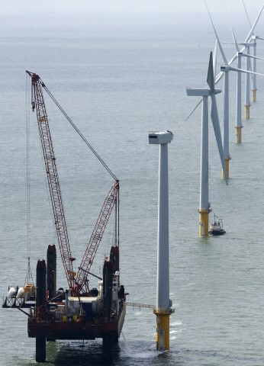


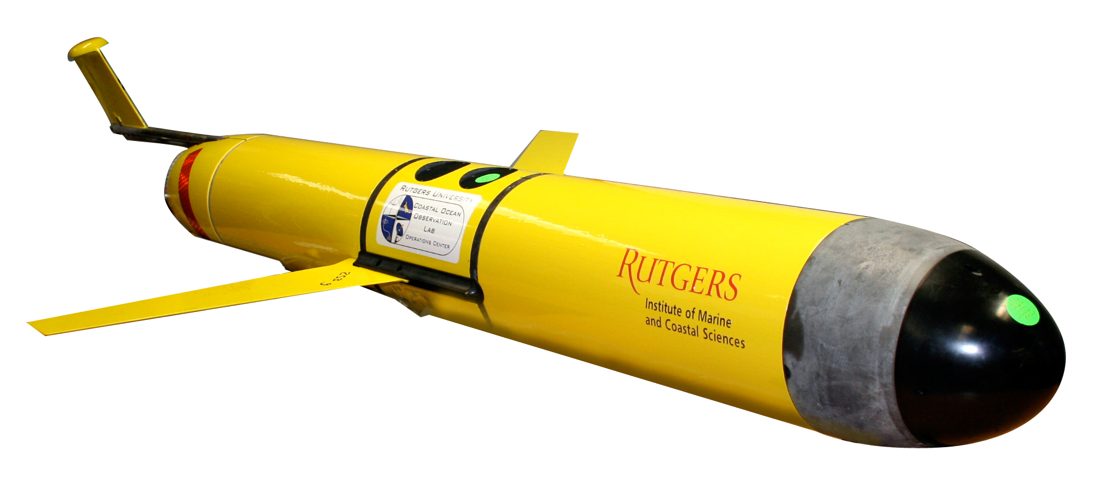

An autonomous-based oceanographic and ecological baseline to inform offshore wind development
Grace Saba, Josh Kohut
Kira Lawrence
Caitlin McGarigal

Slide 2
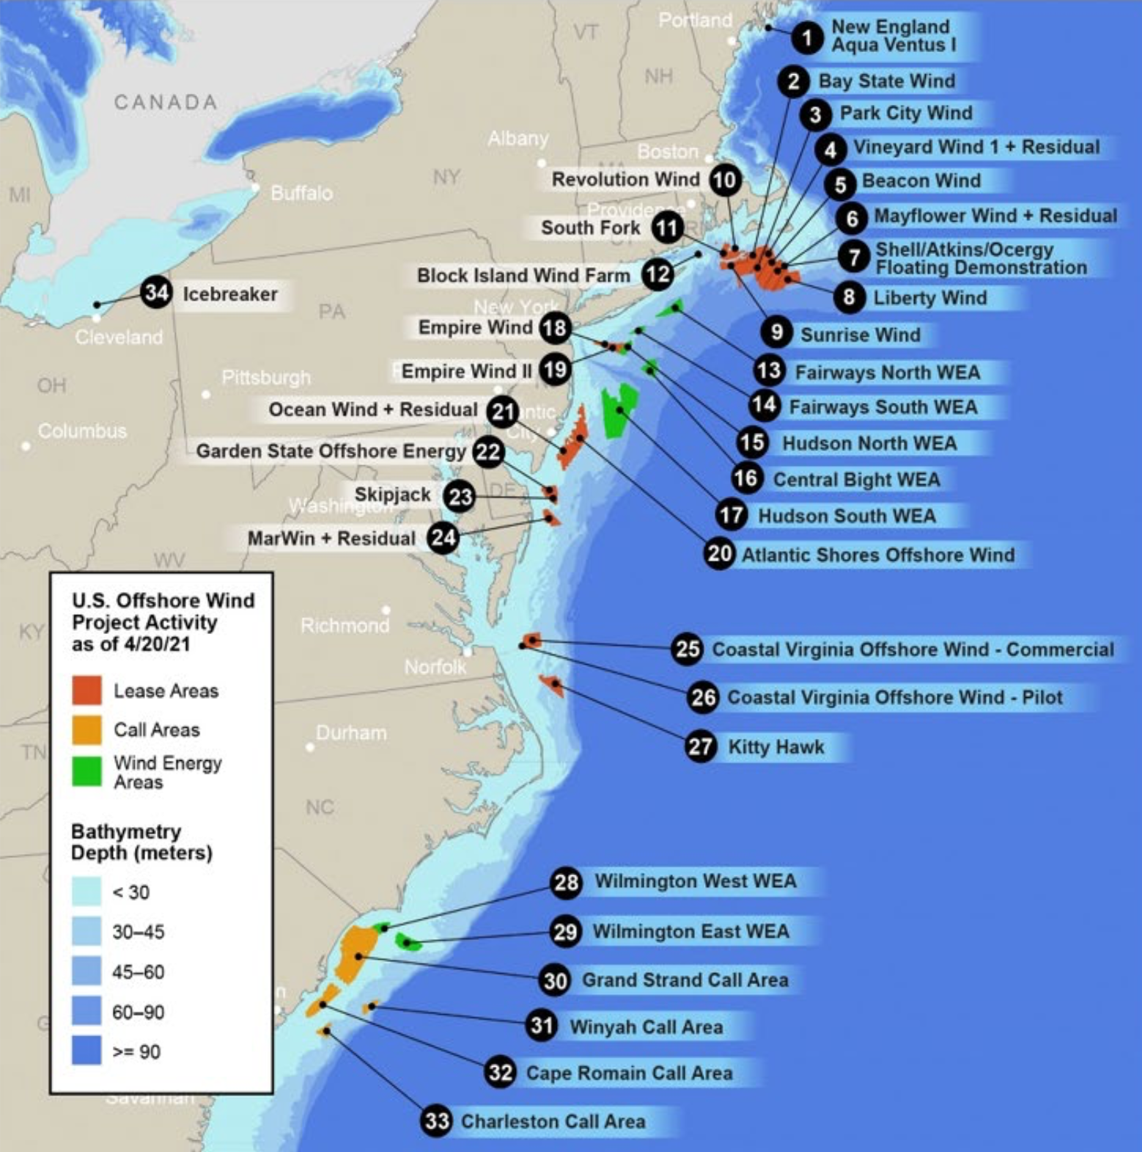
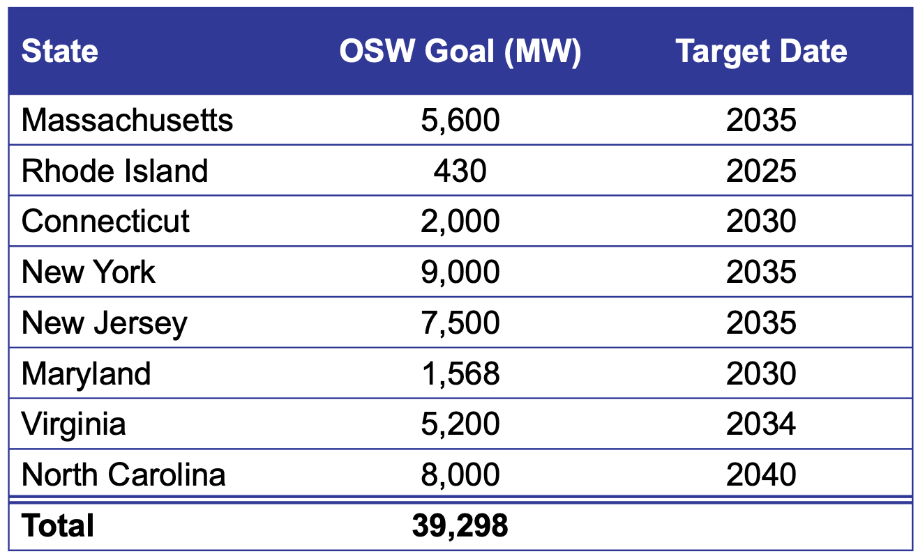
State Commitments to Offshore Wind
Federal Goal: 30 GW by 2030
Source: U.S. Department of Energy;
https://www.energy.gov/sites/default/files/2022-01/offshore-wind-energy-strategies-report-january-2022.pdf

Slide 3
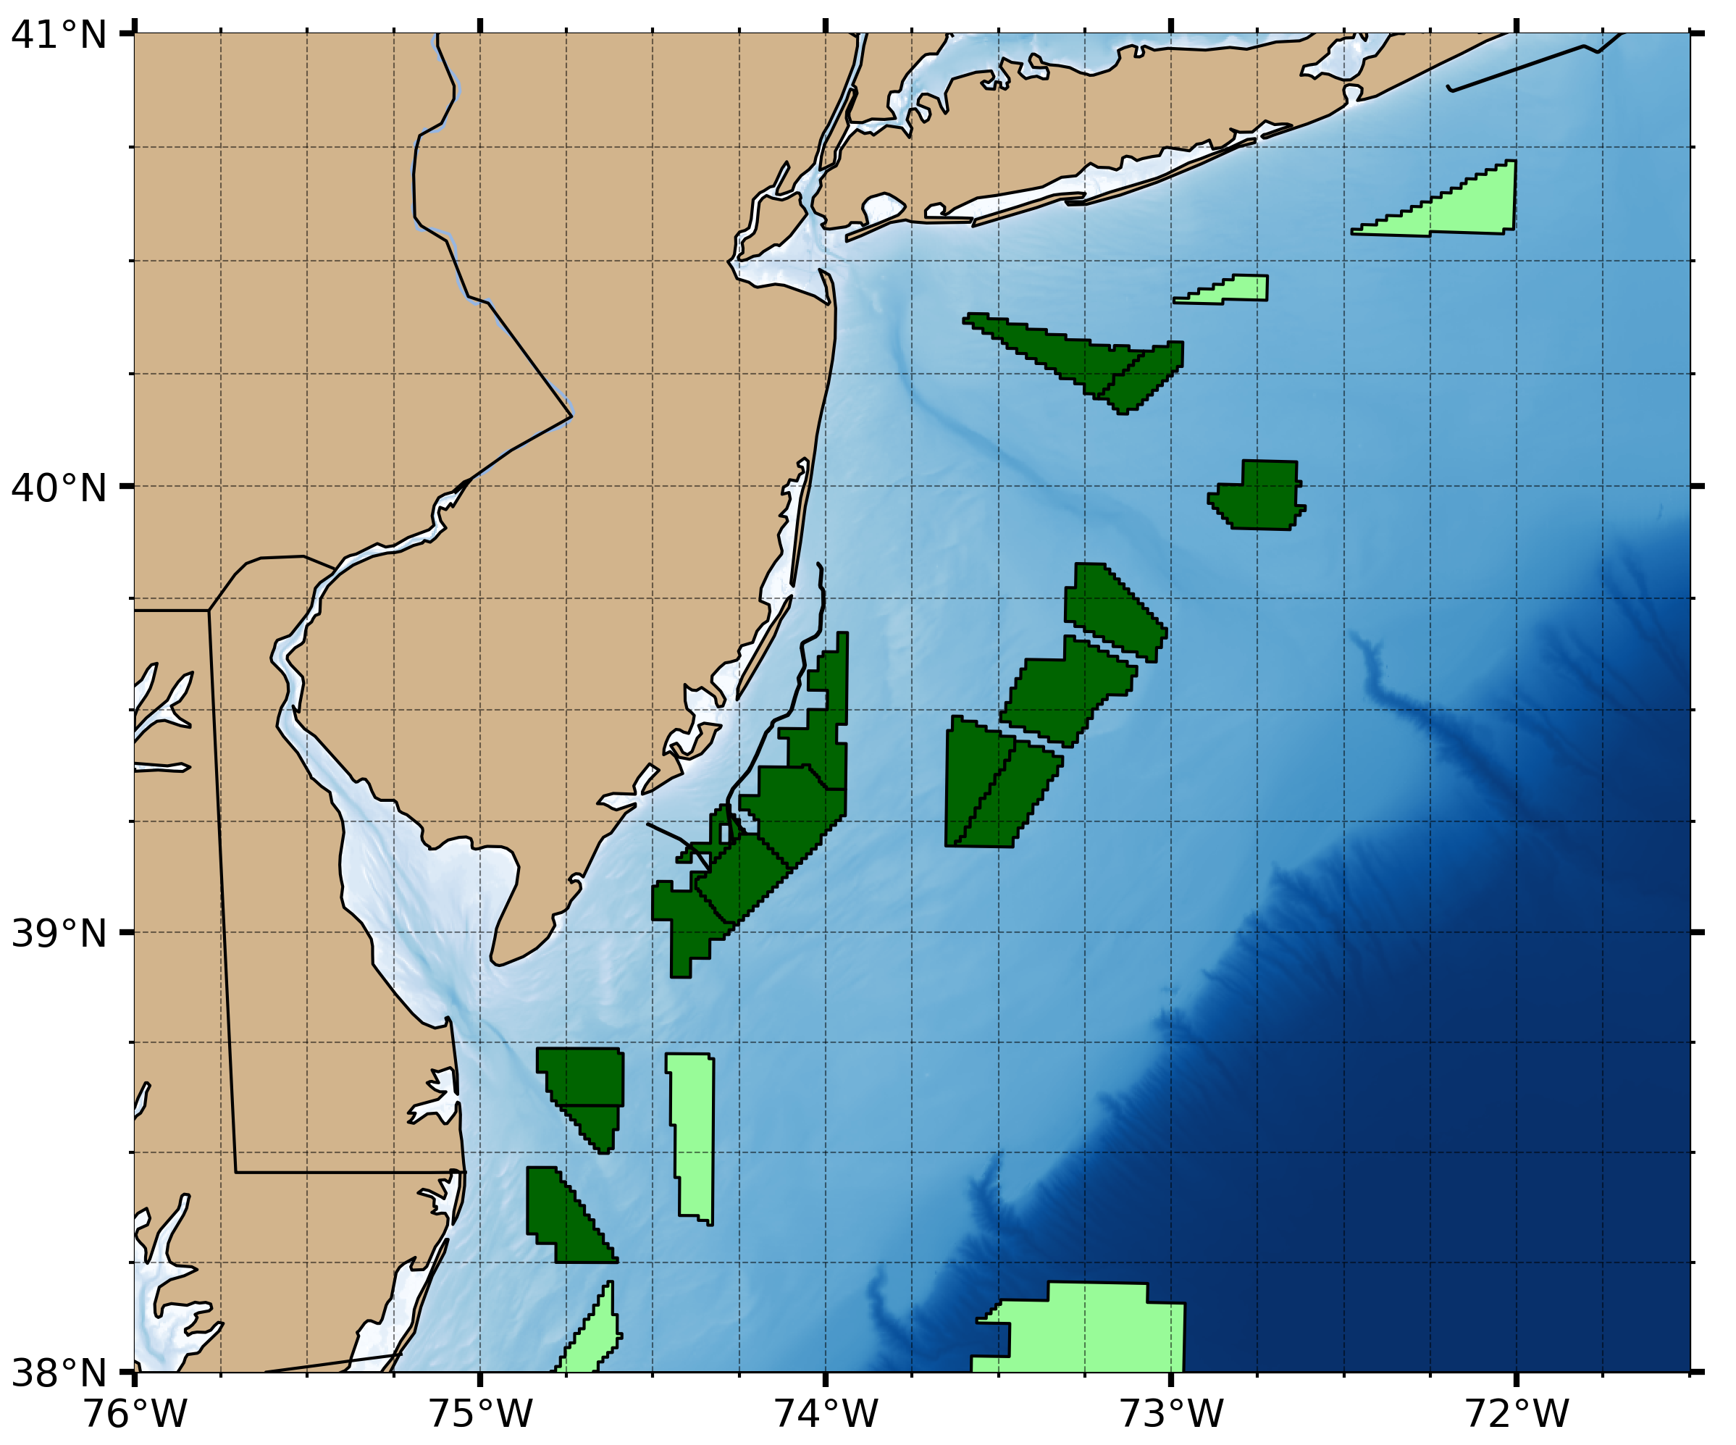
New Jersey Commitments to Offshore Wind
11,000
2040
Lease Area
Planned Area
Executive Order No. 307, 9/21/2022

Slide 4
Need for Ocean Physical, Chemical, & Biological Information
New Jersey coastal shelf system is highly variability and complex
Ocean conditions and organism habitat preferences are tightly coupled
  Distributions can significantly vary on seasonal and annual scales.
New Jersey shelf is situated in one of the most rapidly warming regions in the world and is vulnerable to both ocean and coastal acidification.
Lease Area
Planned Area

Slide 5
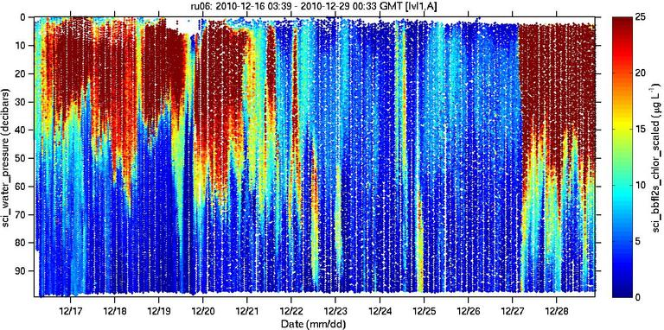
Advantages of Glider-based Monitoring
Sensors we have integrated into ‘ecogliders’:
Temperature & Salinity
Dissolved oxygen
pH, derived Omega
Chlorophyll Fluorescence
CDOM Fluorescence
Optical backscatter
Active acoustics – pelagic fishes (38, 125, 200 kHz)
Active Acoustics – zooplankton (125, 200, 455, 769 kHz)
Passive Acoustics – marine mammal, cod detection
Fish telemetry – fish movement & migration
High-resolution sampling
Sustained ops, cost-effective
Hazardous conditions
Augment vessel-based surveys
Navigate wind farms

Slide 6


Eco-glider Baseline Study: Research Monitoring Initiative
Deploy 3 Slocum gliders to conduct baseline surveys
4 seasonal deployments (multi-year) of paired gliders with a full complement of available sensors to simultaneously capture oceanographic and ecological variables
3rd glider – 3 deployments in between paired deployments; to capture stratification set-up to fall breakdown

Slide 7
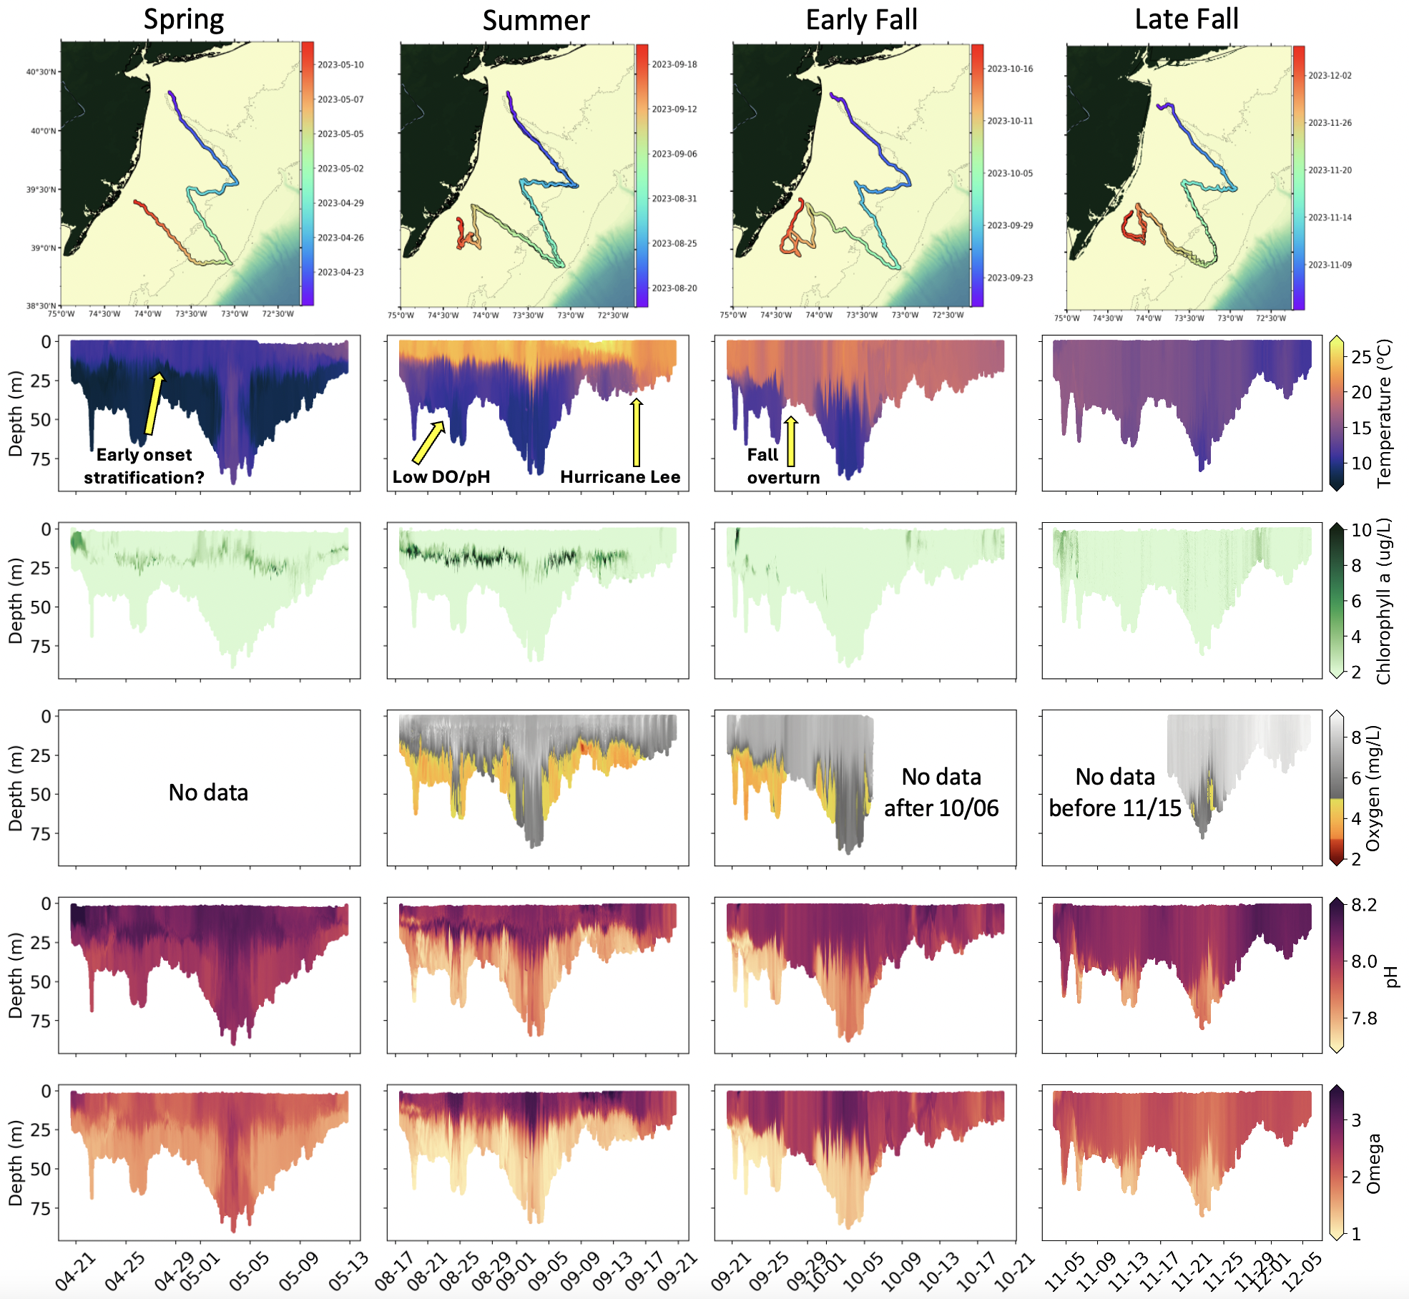
Seasonal Evolution of Oceanographic Properties
Monitoring strategy increases our ability to:
Characterize the true variability of the system
Relate the physical, chemical, biological variables
*PRELIMINARY DATA

Slide 8
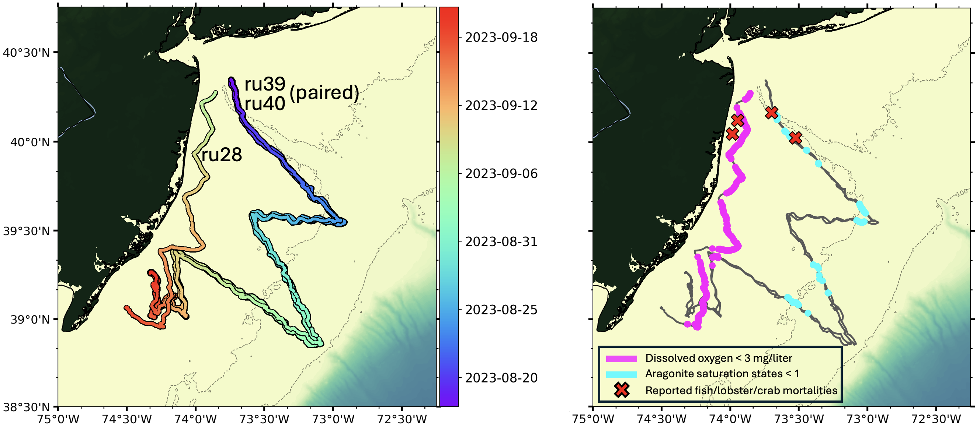
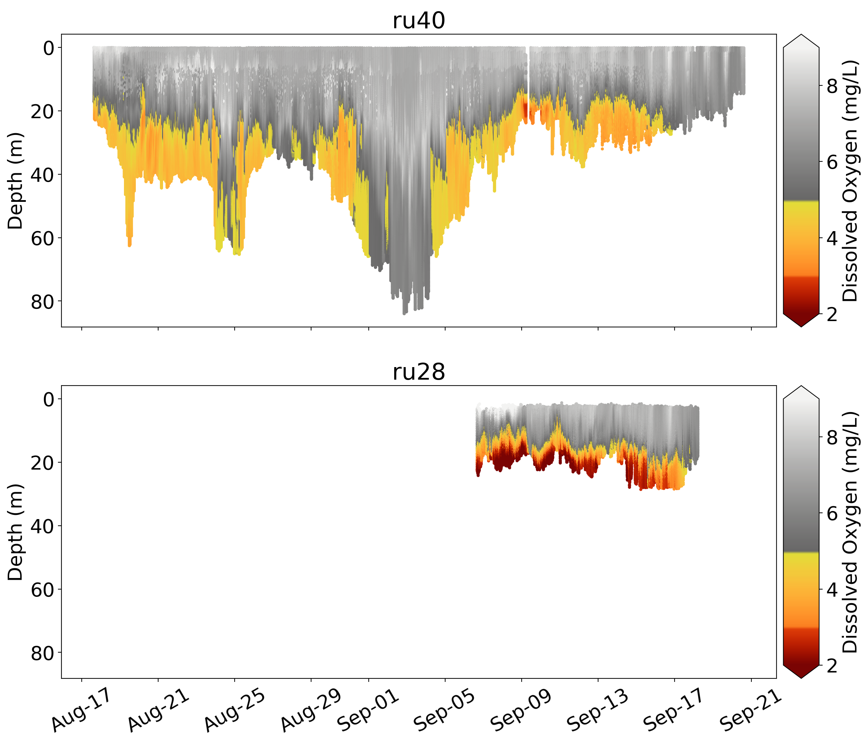
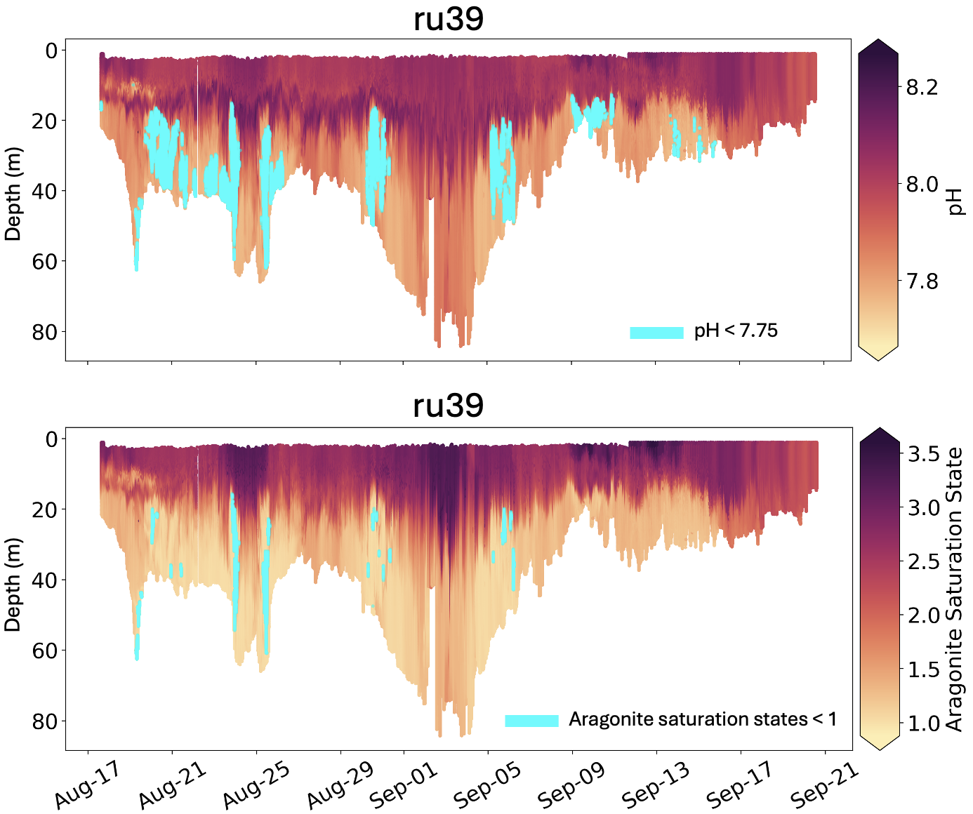
Observation of Multi-stressor Events
Extensive shelf area with low DO & pH
Reported fish, lobster, & crab mortalities from fishers
Persistent throughout deployment, minimized & alleviated once strong storms occurred
*PRELIMINARY DATA
Notes:
pH: minimum = 7.66 (max = 8.27 in chl maximum)
Ωarag: minimum = 0.88 (max = 3.60 in slope surface water)

Slide 9
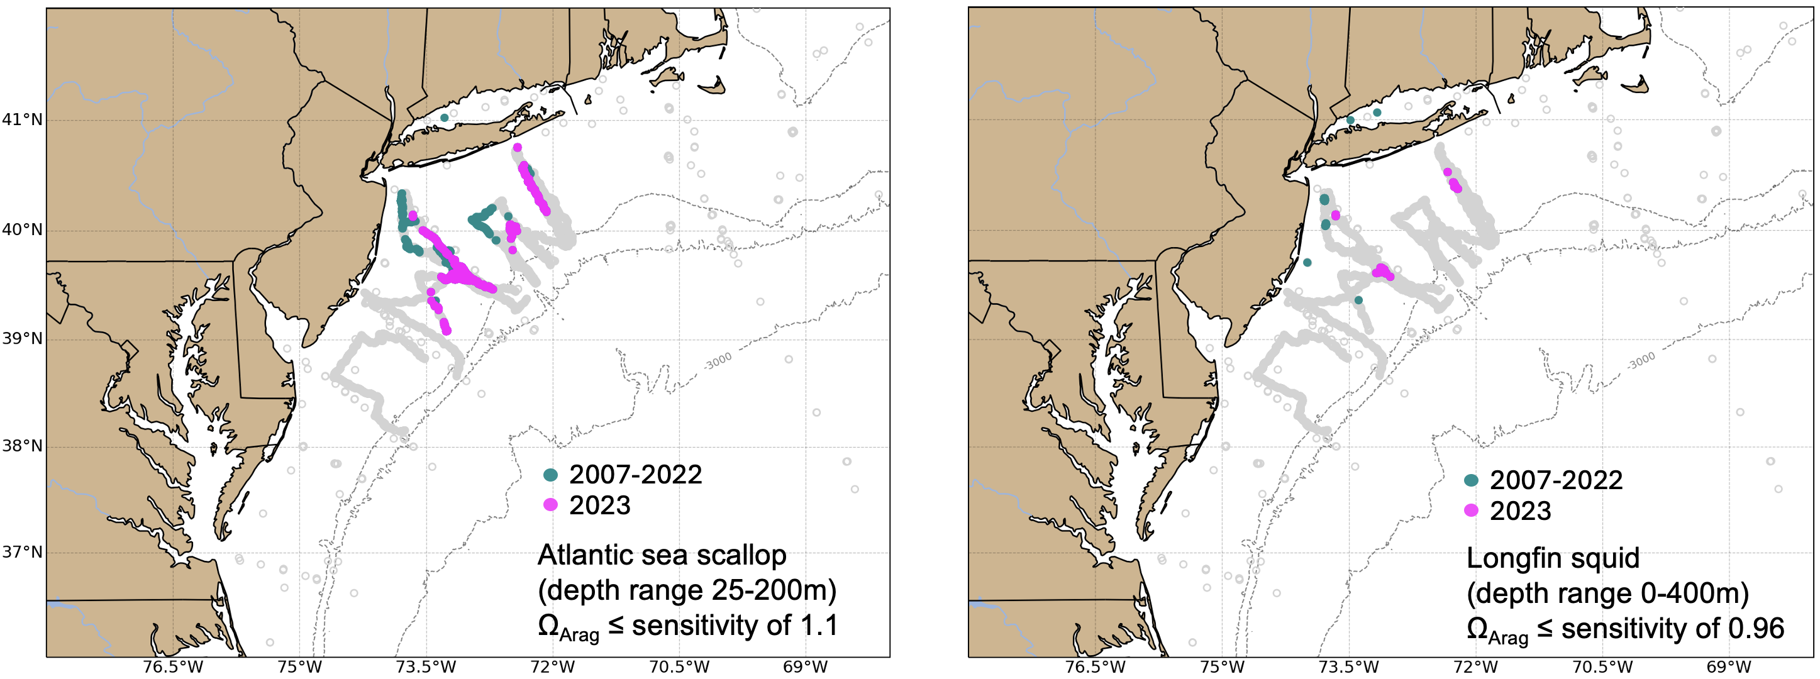
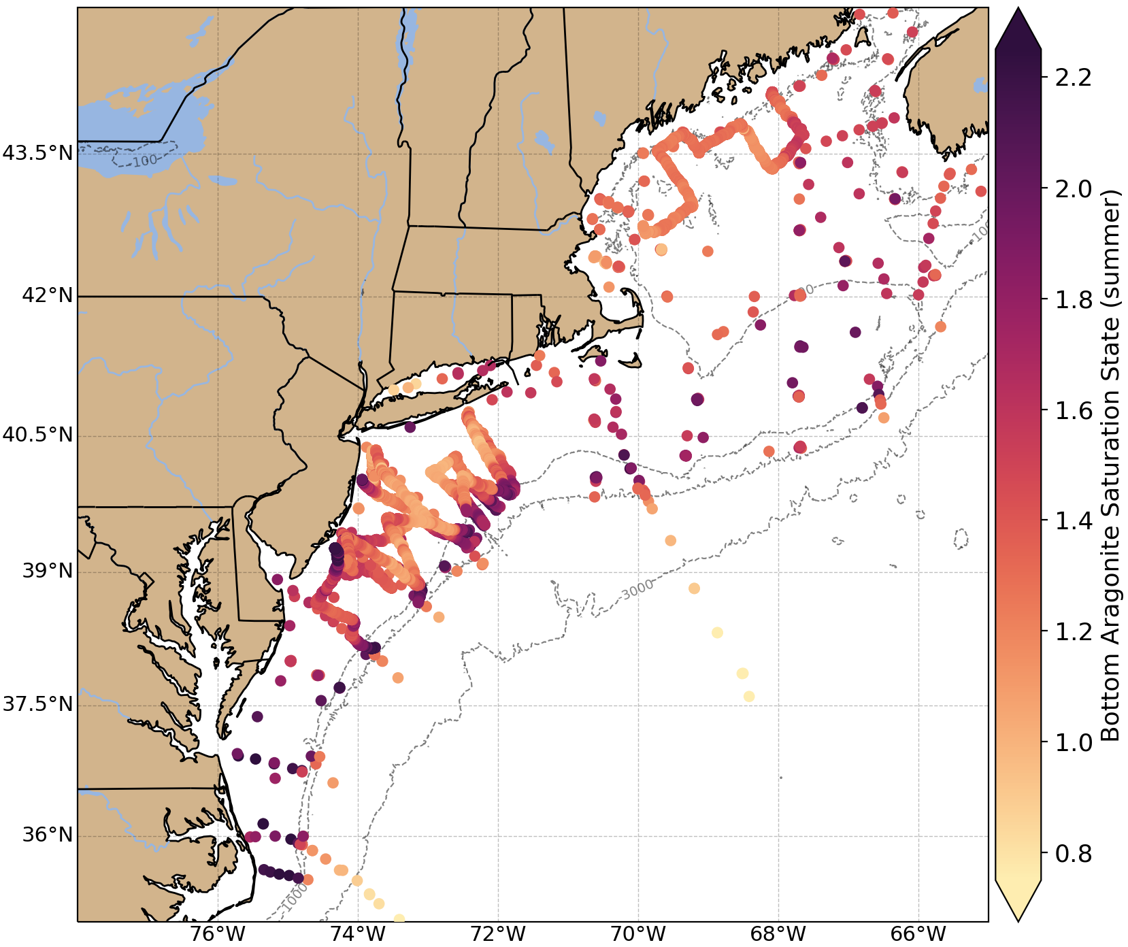



Conveying Information for Management
NOAA State of the Ecosystem: Mid-Atlantic and New England (reports for MAFMC and NEFMC)
2007-2023

Slide 10
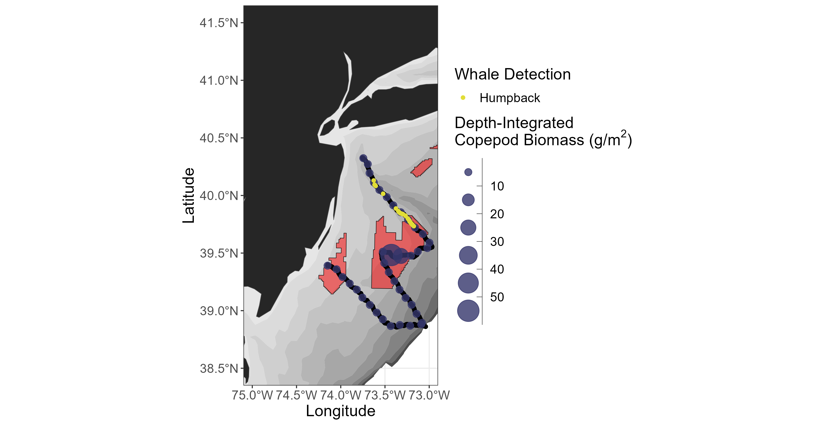
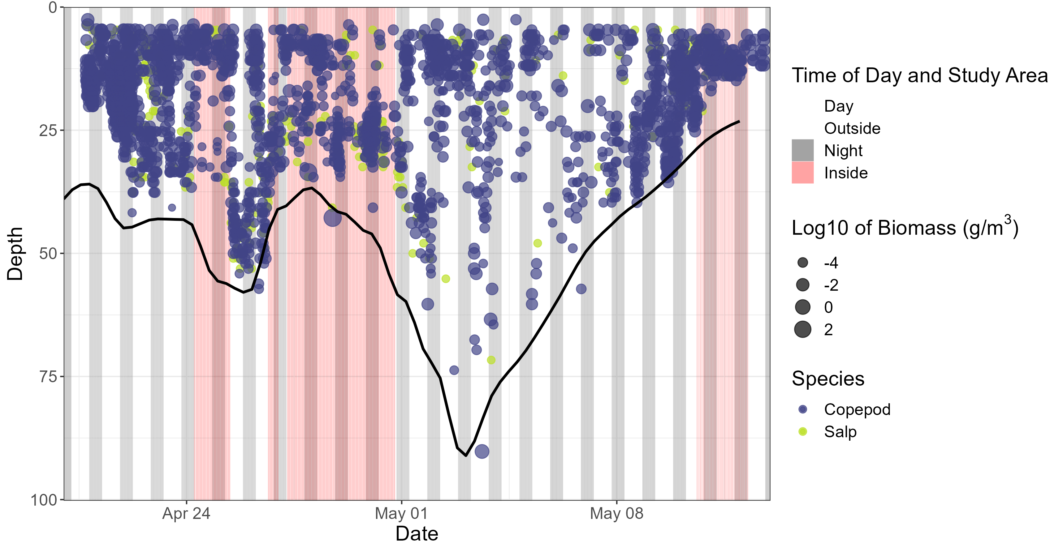
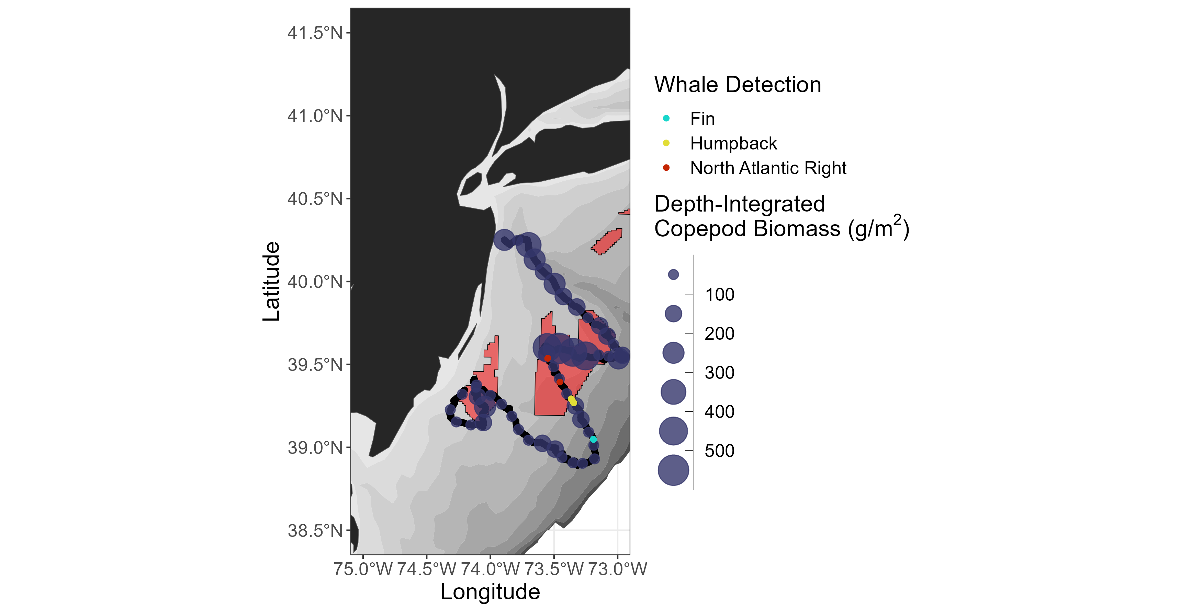
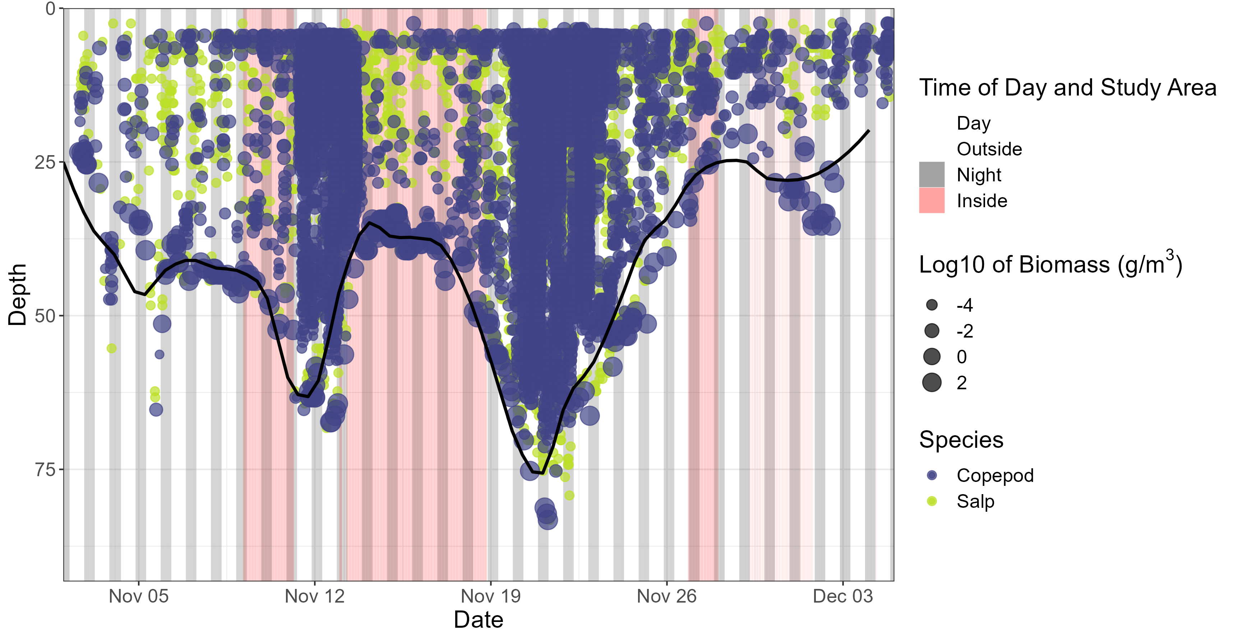

Co-location of Zooplankton & Whale Distributions
SPRING
Exploring overlap between oceanographic features and distribution of zooplankton, fishes, and marine mammals; between marine mammal predators and their prey
*Copepod only
FALL
*Copepod only
*PRELIMINARY DATA
Notes:
NOTE: Biomass estimates correspond to copepods only; salps are presence/absence (don’t have good enough salp TS models to estimate biomass/abundance)

Slide 11
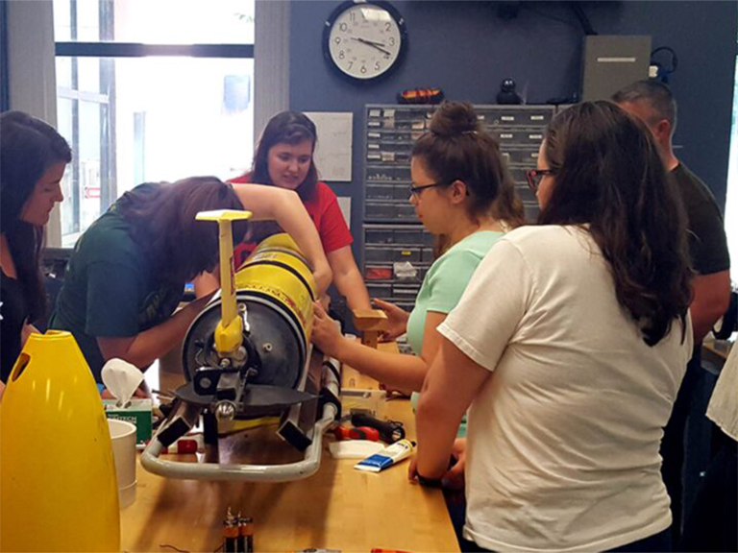
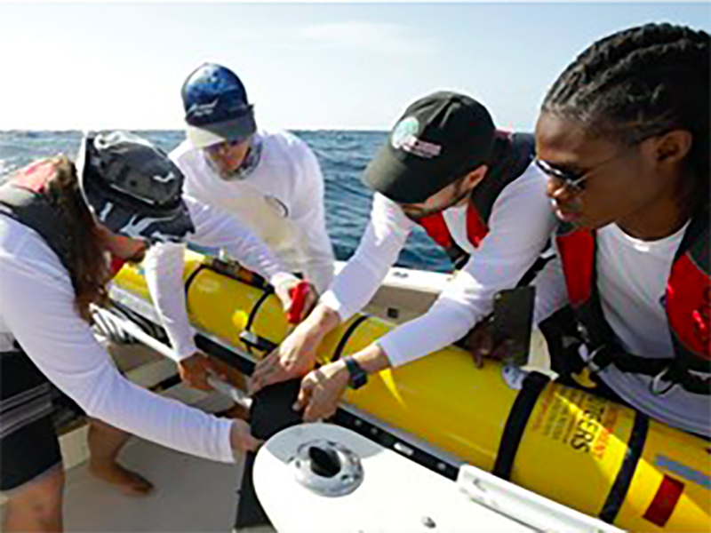
Summary
This project is providing a seasonally-resolved 3D view of regional ocean and ecological conditions that includes physical and chemical variables, and biological variables spanning multiple trophic levels – from phytoplankton and zooplankton to pelagic fish and marine mammals.
NEXT STEPS
Conduct rigorous, hypothesis-based, and scientifically defensible monitoring and research that addresses New Jersey’s highest research priorities:
  Examine seasonal habitat use of marine mammals and drivers of those patterns
  Examine impacts of OSW development on oceanographic variables and organism biomass/distribution/connectivity

Slide 12
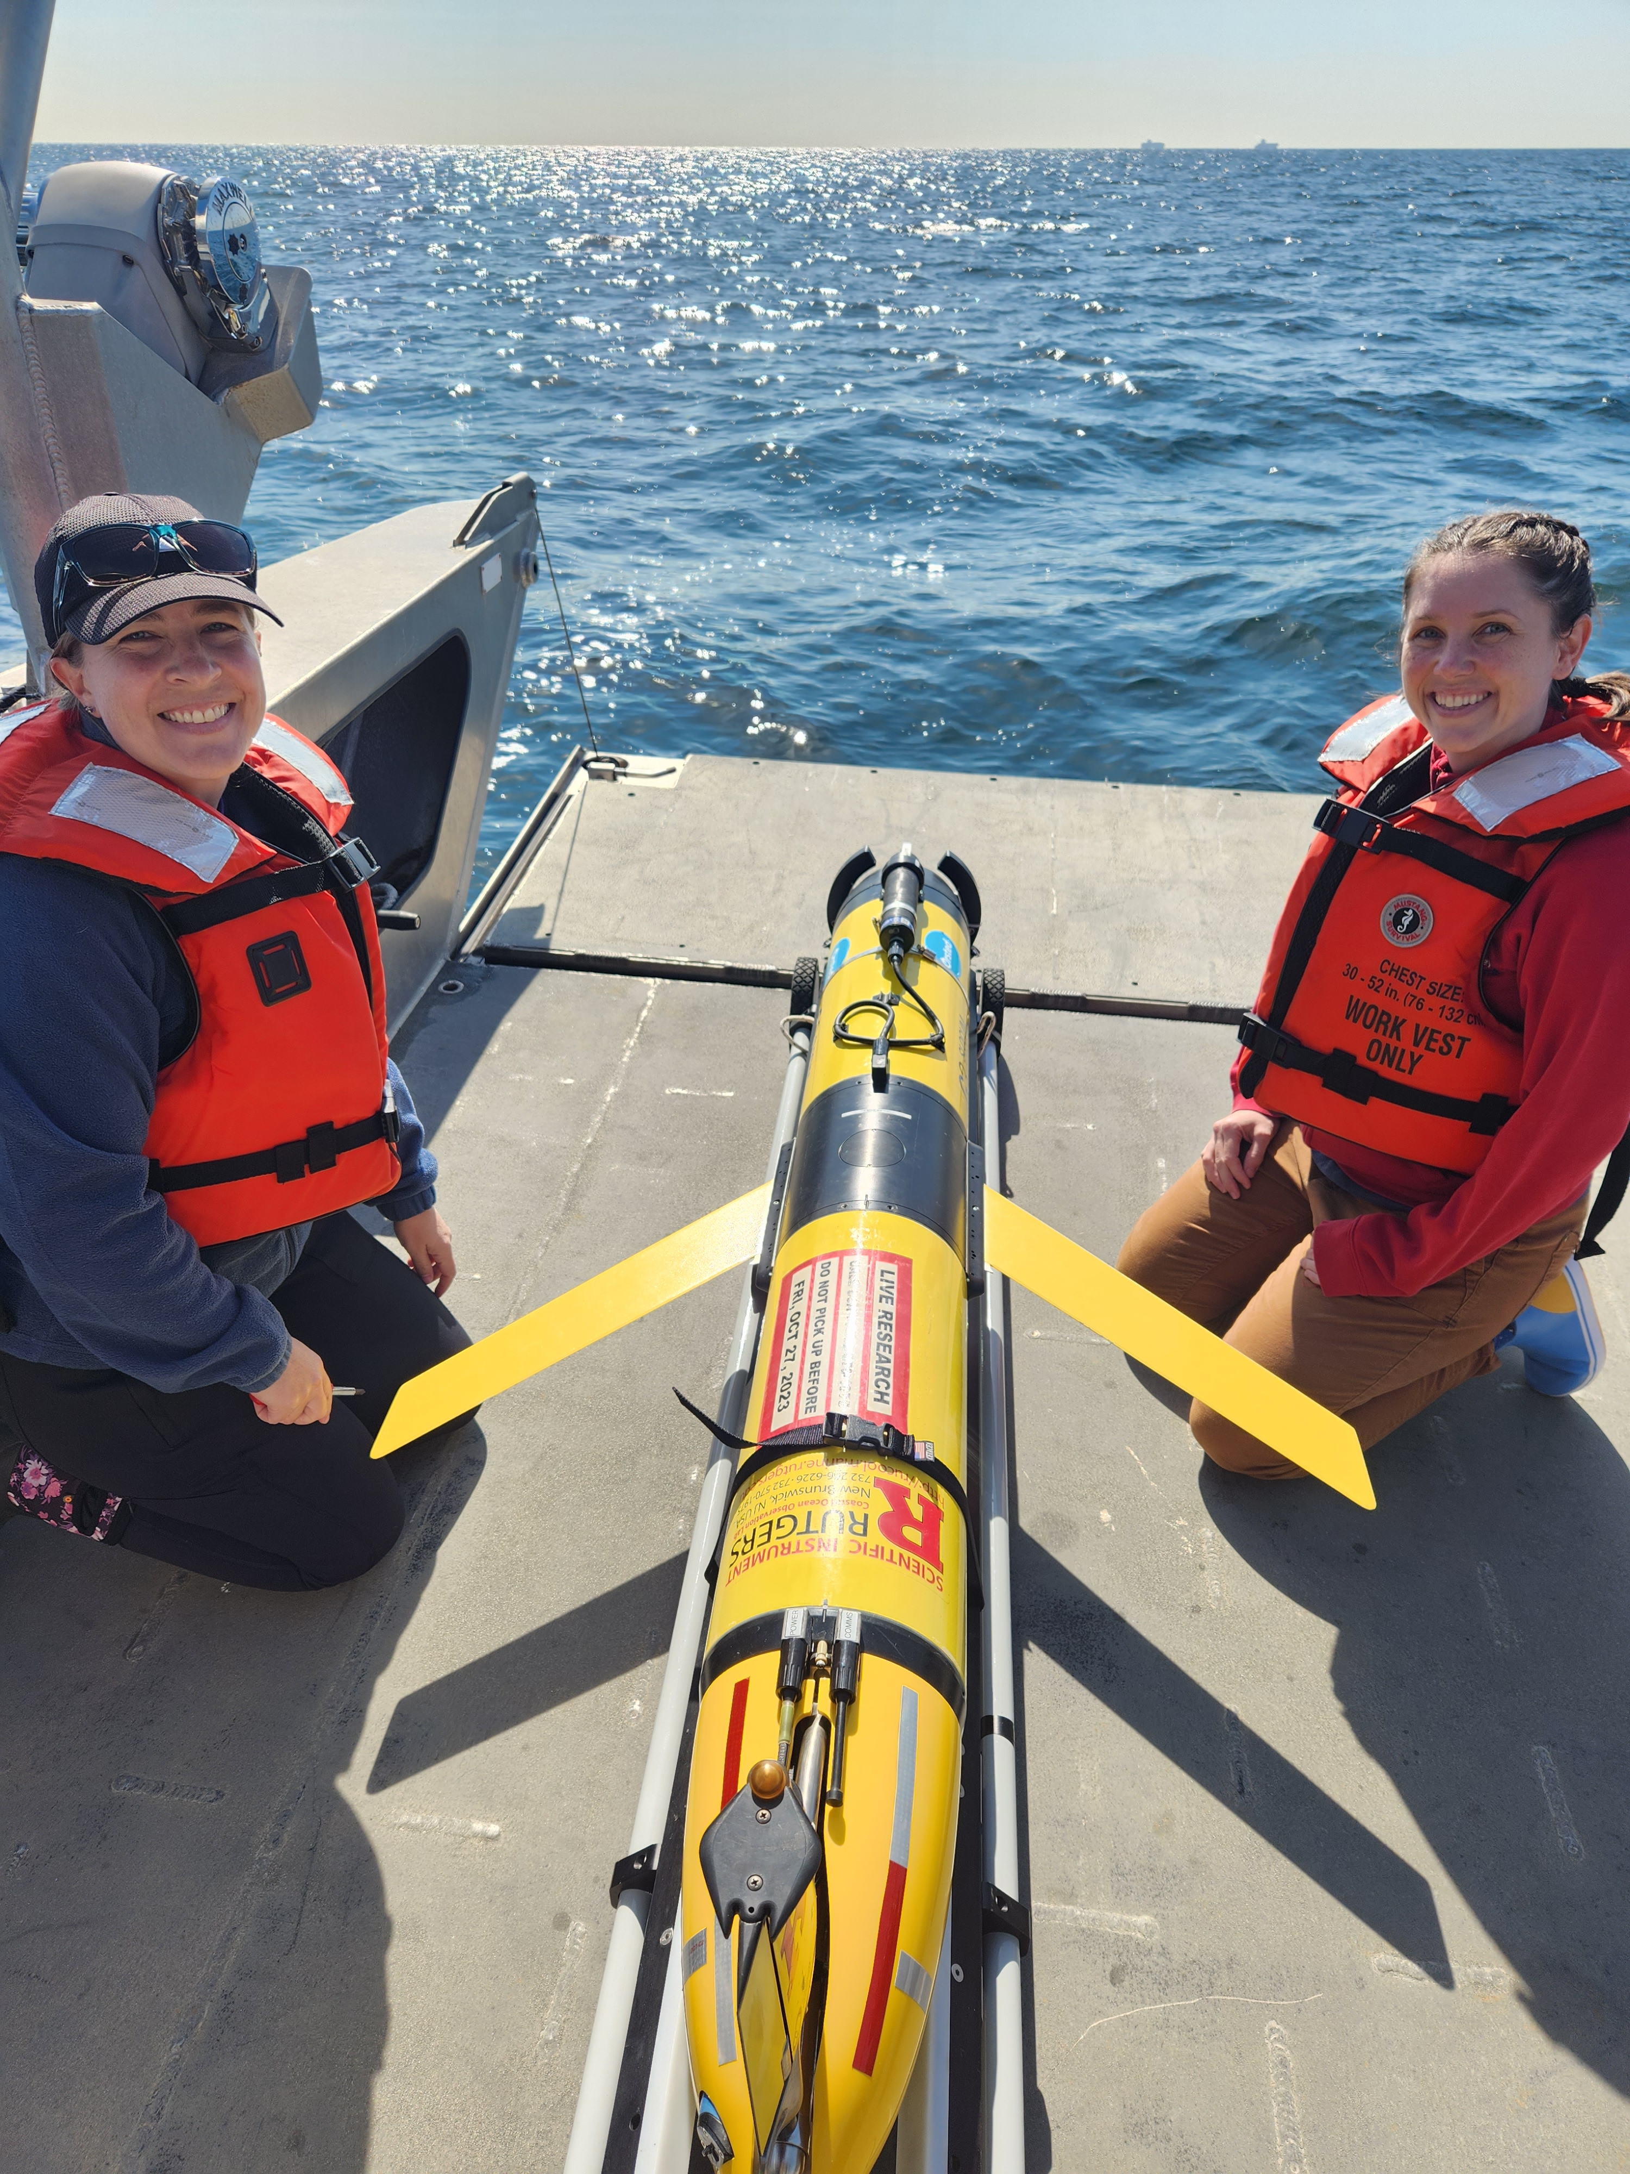
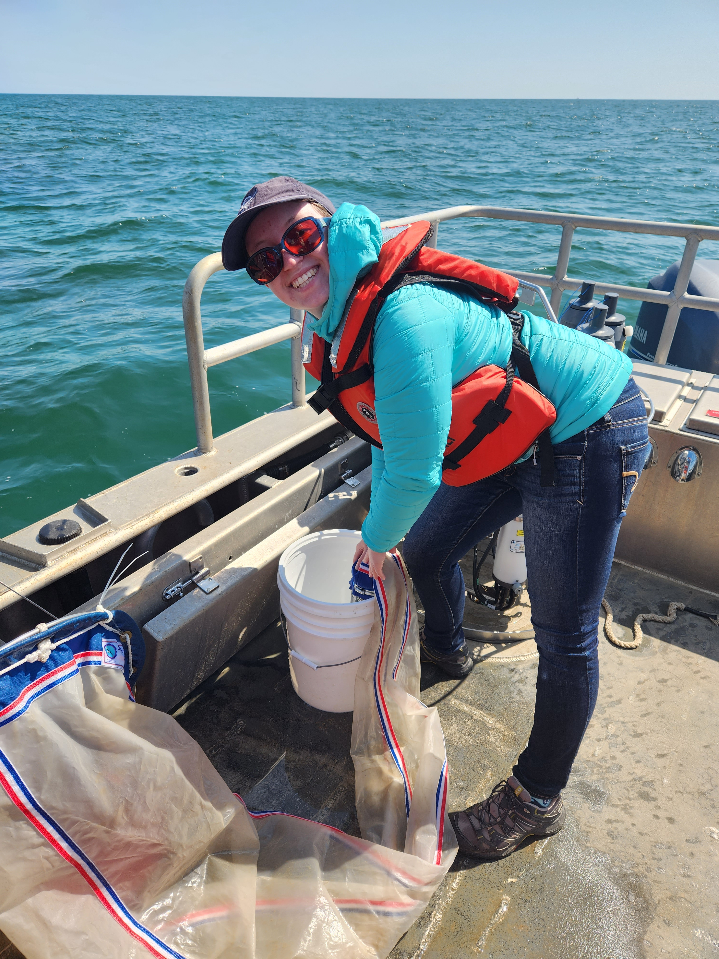
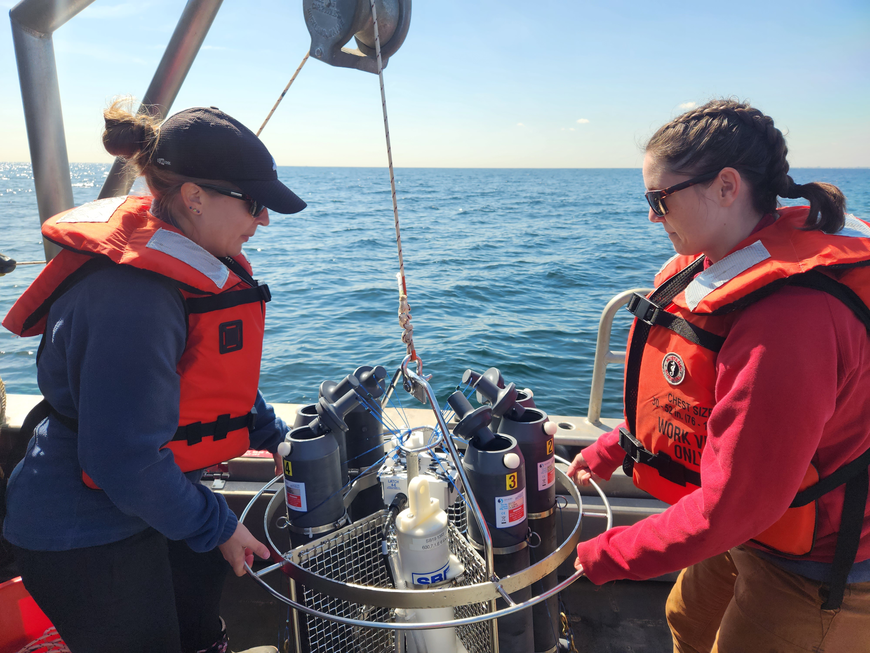
Thanks! saba@marine.rutgers.edu kohut@marine.rutgers.edu
Acknowledging RU Technical Staff:
Kaycee Coleman, Mike Crowley, David Aragon, Nicole Waite, Brian Buckingham, Jessica Leonard, Lori Garzio, Delphine Mossman, Laura Nazzaro

